Slide 1
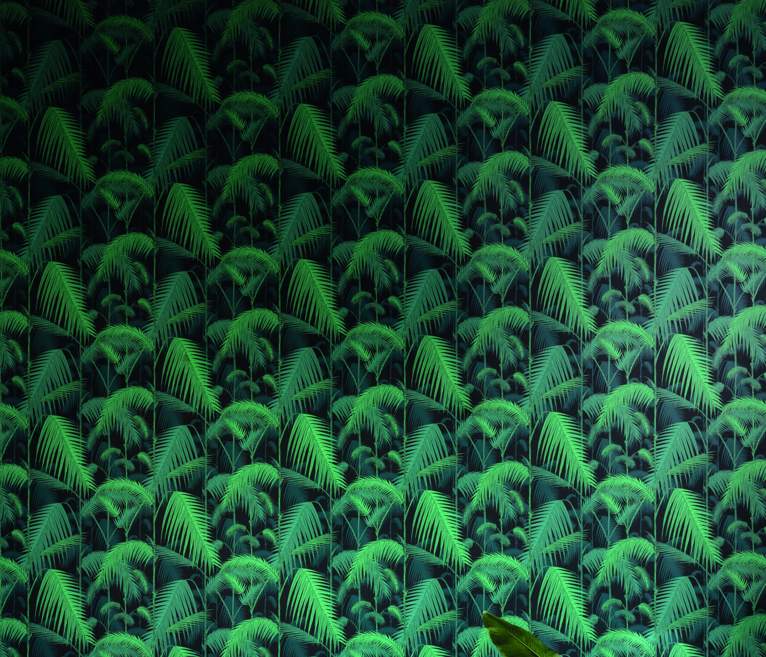


CATEGORY 1
A Captivating Conversational Design
Sponsored by
Cole & Son has been creating original and exceptional wallcoverings and fabrics since 1875. The in-house design studio continues to produce innovative and timeless designs which reflect our long and distinguished history as well as our continuing passion for artistic design and quality craftmanship.
The Cole & Son design studio is a hub of creativity more akin to an artist’s atelier. Ideas come predominately from the illustrator’s own photographs, taken on immersive trips to inspirational locations which inspire the narrative behind each design.

Slide 2
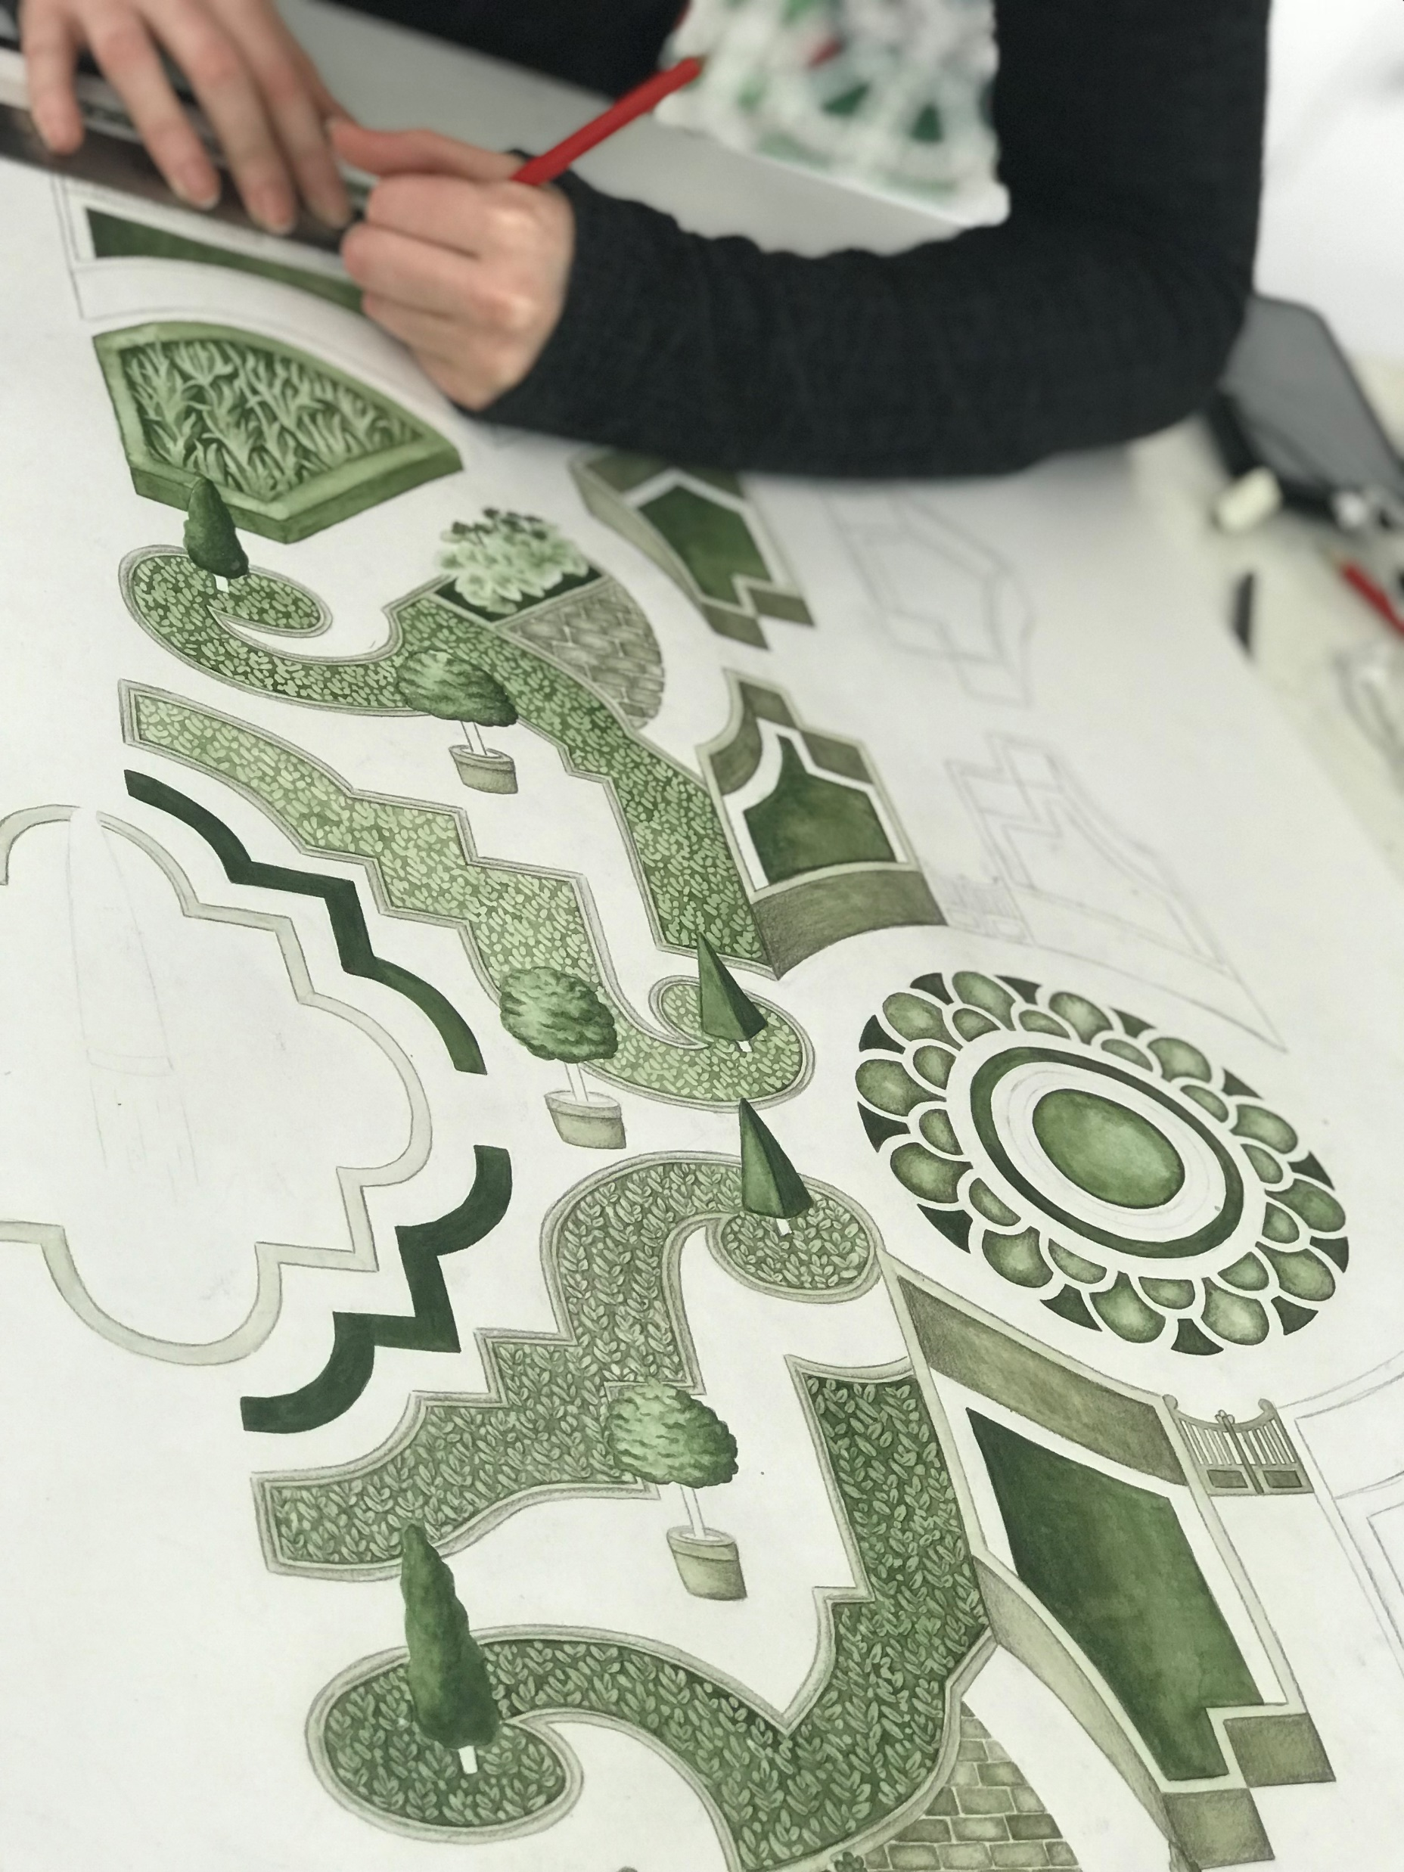
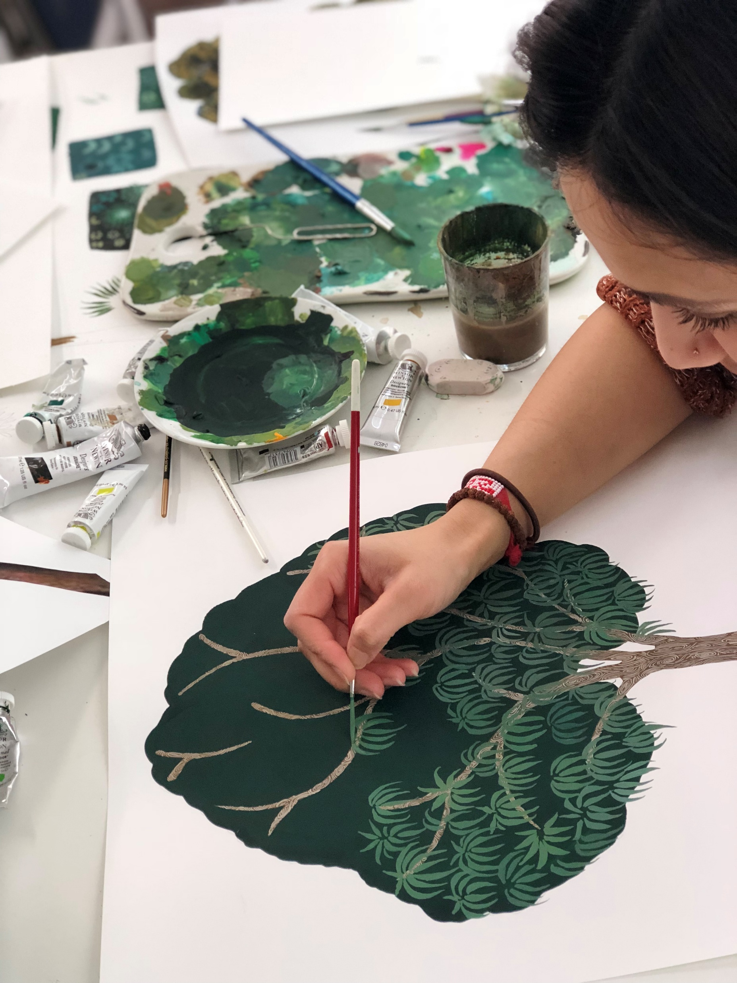
DESIGN BRIEF
A Captivating Conversational Design
To create an exuberant design with a strong narrative to inspire the imagination for years to come. Create a new and exciting conversational design, combining colour and pattern to produce a unique, distinctive and inviting design for the interior. Illustrate your hand drawn/painted skills in an original but disguised repeat.
Inspiration:
Your story telling could be taken from visiting a beautiful country with an immense culture, historical building with vast heritage or be inspired by the captivating beauty of nature.
Repeat & Scale:
The structure & scale of a repeat is what gives a design its movement and, if it were a wallcovering defines how it balances when several drops are hung side by side on a wall. Ideally, we are looking for a fluid and seamless structure for your design. Scenes and conversational drawings can be tricky to place into a repeat, therefore consider the structure of your design to help anchor the novelty aspects within the repeat unit.
Colours:
There are no limits!
2

Slide 3
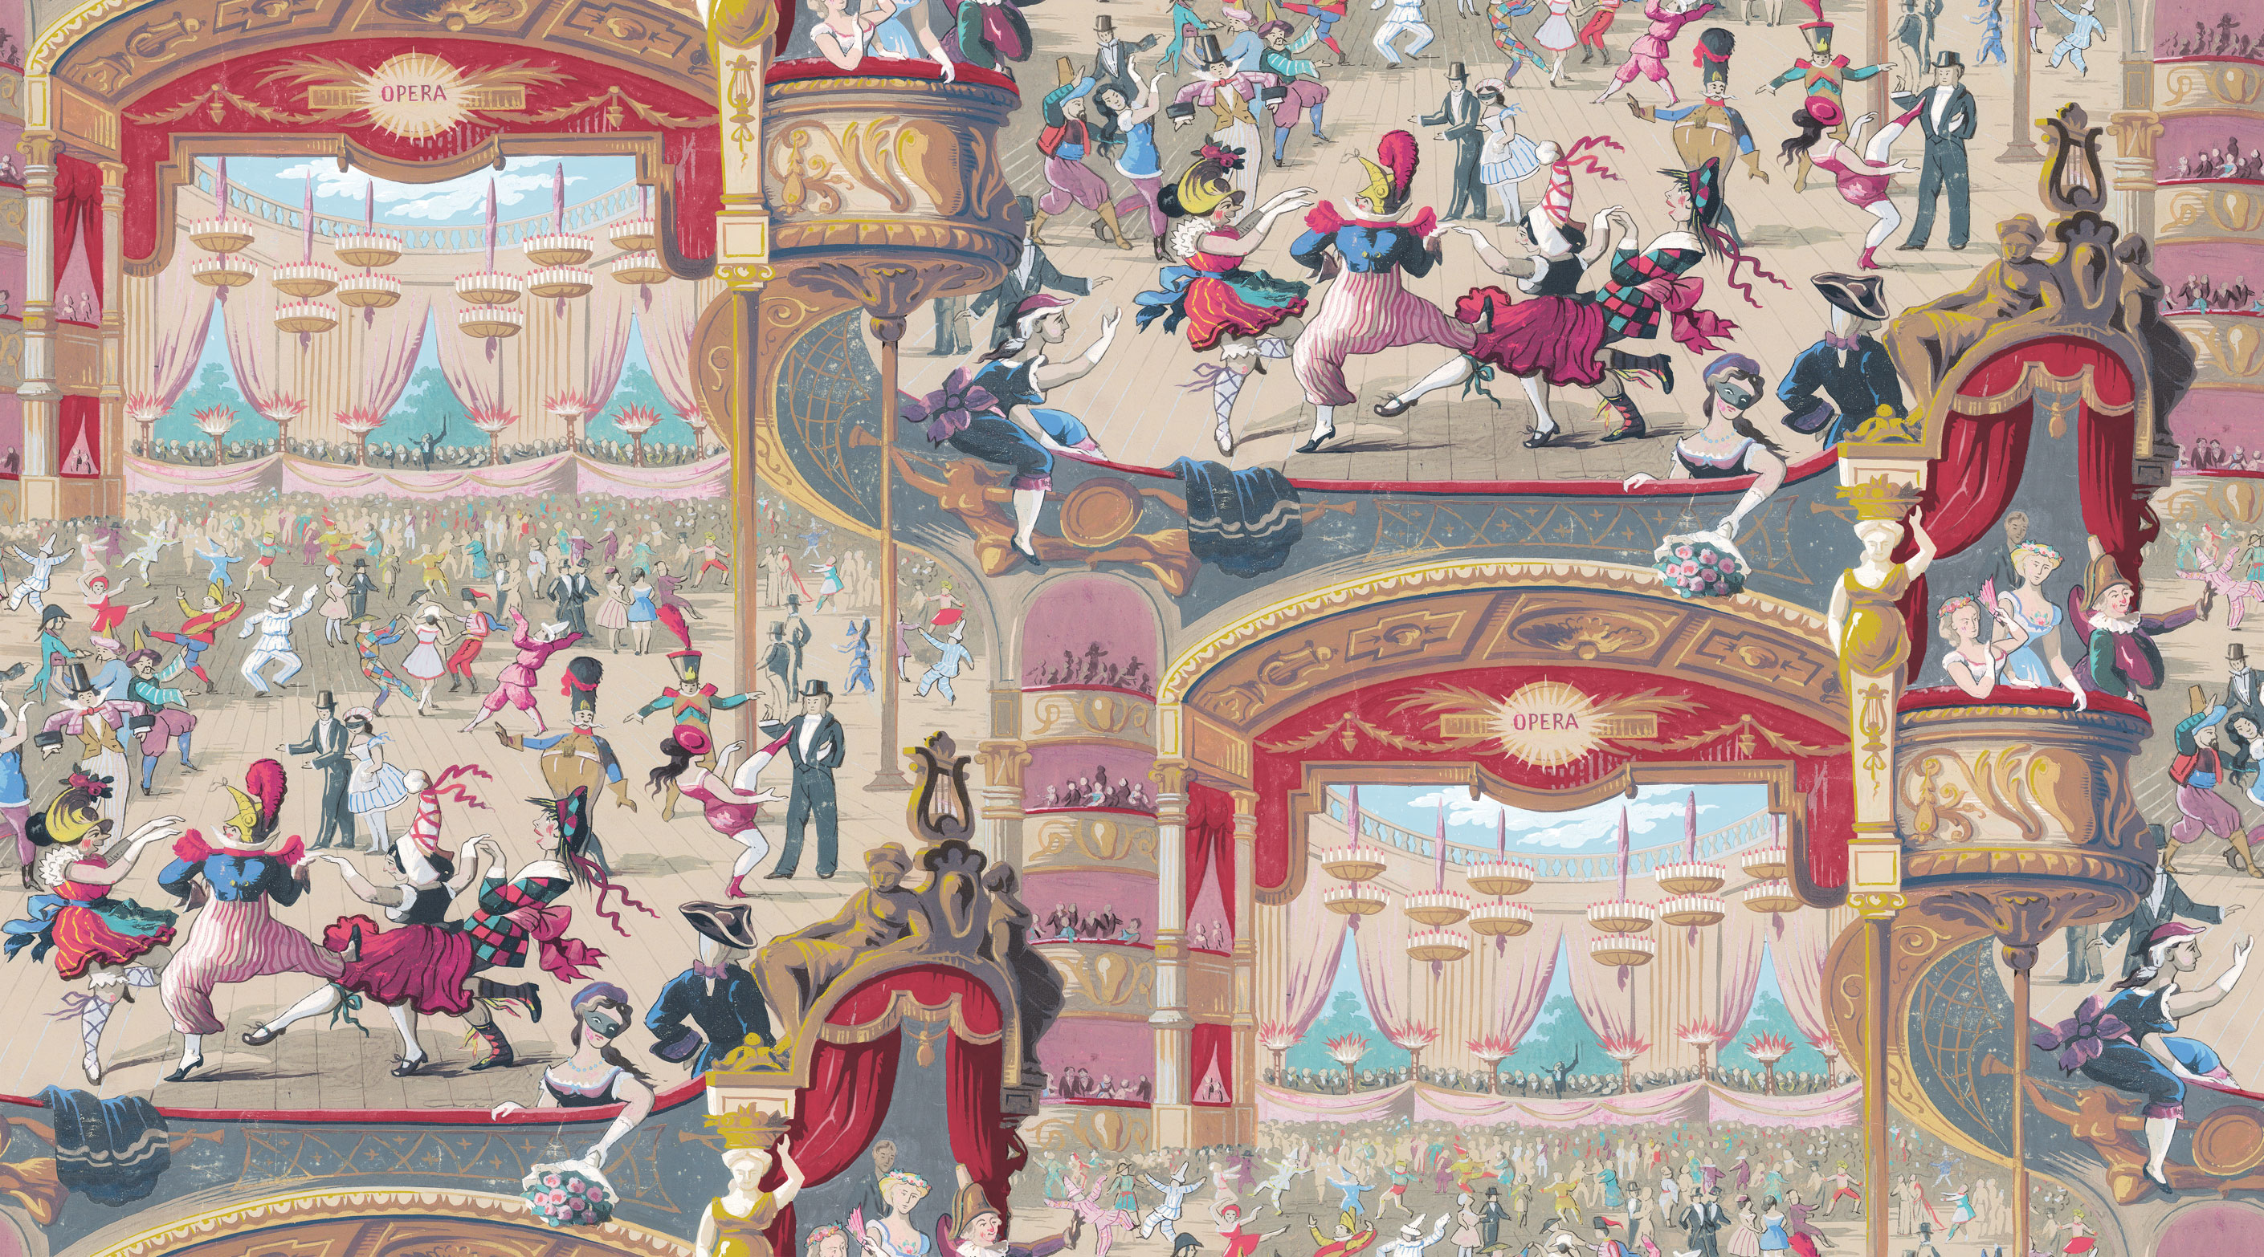
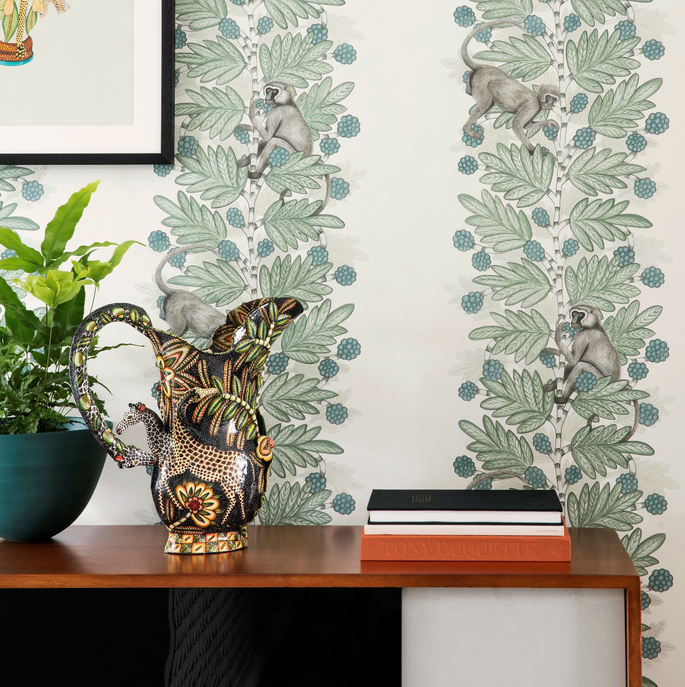
Examples
CABARET is an enchanting wallpaper with a strong narrative, inspired by the classic fairy tales of youth. With its carnival imagery and colouring, featuring whirling dancers and entertainers it is reminiscent of vintage illustrations found in childhood story books.
ACACIA from The Ardmore Collection. The Acacia tree is an enduring sight in Africa with its bright yellow ‘fluff-ball’ flowers, and holds warm memories for Ardmore founder Fee Halsted. Having always had monkeys around her as a child, these humorous animals full of wit, pranks and intelligence have created a soft spot in her heart, and in turn have provided the inspiration for this striking new ‘conversational’ wallpaper painted by Cole & Son.

Slide 4
Technical Brief
Recolouring of the same design is not acceptable as a subsequent entry
Do not enter the same design into more than one category
Each design should be original and not a modified version of a previous design
Ensure that all channels/layers (separations) of your work are of the same dimensions
Your design is to be worked up to fit in one of these dimension options (table below) but can have more than one repeat within your selected option: that is to say that if your finished work measures e.g 26.50cm x 26.50cm you must step the work up and across the sheet to fit your selected dimensions, making sure that the units match in height and width. Units can be straight or off set.
All designs must show a match in the height and width regardless of the unit size.
Size | Height (cm) | Width (cm) | End use
1 | 53 | 52 | Wallpaper
2 | 53 | 53 | Wallpaper
3 | 64 | 52 | Wallpaper
4 | 64 | 53 | Wallpaper
5 | 64 | 64 | Textiles
6 | 91.50 | 91.50 | Textiles
7 | 64 | 220 | Textiles
8 | 300 | 140 | Digitally printed wallpaper or textiles
DO NOT SUBMIT MULTIPLE REPEATS OF A DESIGN OUTSIDE THE STATED DIMENSIONS
DO NOT MOUNT THE DESIGN ON ANY SECONDARY MEDIA E.G. CARD OR BOARD
Label your artwork discreetly, using pencil, with your name and category entered on the reverse at the bottom left corner.
Submit a digital image at 300dpi, showing the separate channels/layers which matches your physical entry/s exactly
The images to be supplied in Tiff format only
Send your entries to:
i-dott CIO Suite 23 Blackburn Enterprise Centre Furthergate Blackburn BB1 3HQ
You can contact us at: +44 (0) 7538673651 info@i-dott.org
Remember to enclose your completed & signed Entry Form and Assignment of Copyright document

